Slide 1
Homework 1: Grade Table
Please design a grade table with 4 fields:
seat number, Chinese, English, Math
Implement 4 features:
enter grade, print grade, sort, and exit
Please use dynamical Array instead of static ones
ex. int[] arr = new int[size];
Use Array.Sort(key, value) to sort both array by key
See screenshot in next page for details

Slide 2
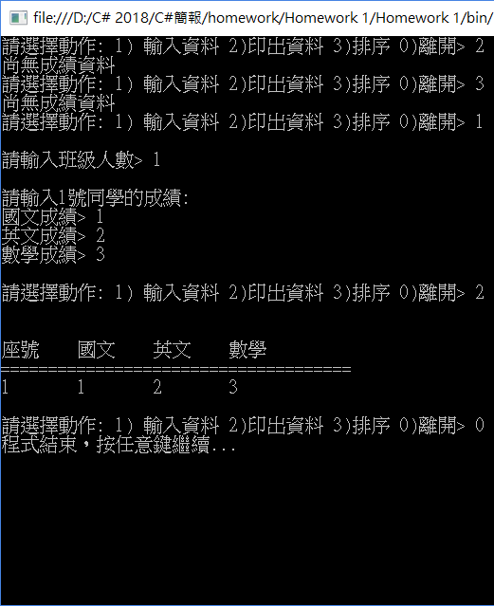
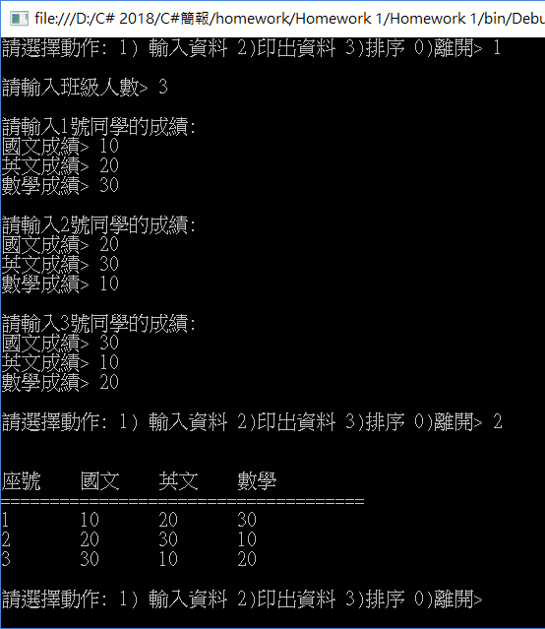
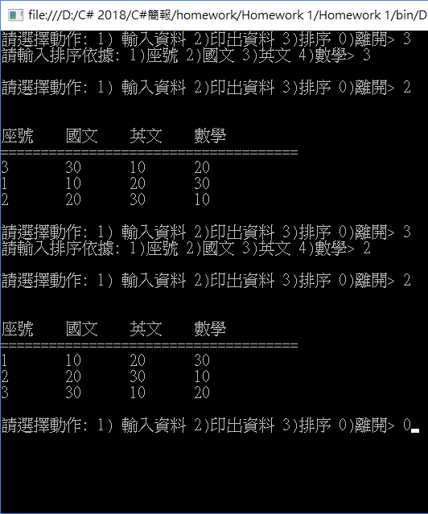
Homework 1: Grade Table

